Slide 1


Presentation on “Autoencoders”
Presented By
Thorve Avishkar Shrikrushna
Third Year of Artificial Intelligence and Data Science
Engineering
Department of Artificial Intelligence and Data Science Engineering
Jaihind College of Engineering, Kuran
SAVITRIBAI PHULE PUNE UNIVERSITY
2024-2025

Slide 2
CONTENTS :
Introduction
Problem Statement
Motivation
Goal /Objectives
Literature survey
System Architecture
Algorithmic survey and Selected Algorithm
Results Analysis
Advantages & Application
Future scope
References
Conclusion

Slide 3
INTRODUCTION :
Autoencoders are a class of artificial neural networks primarily used for unsupervised learning tasks, where the goal is to learn a compressed or reduced representation of input data. The network is trained to encode the input into a latent space of lower dimensionality, referred to as a "bottleneck," and then decode it back to the original data. This forces the autoencoder to capture the most important features of the data while discarding noise or redundant information.

Slide 4
MOTIVATION :
Dimensionality Reduction
Data Compression
Feature Learning
Generative Models

Slide 5
GOALS/OBJECTIVES :
Encoder: Maps the input data to a lower-dimensional latent space representation.
Latent Space: A compact representation of the input data.
Decoder: Reconstructs the input data from the latent space representation.

Slide 6
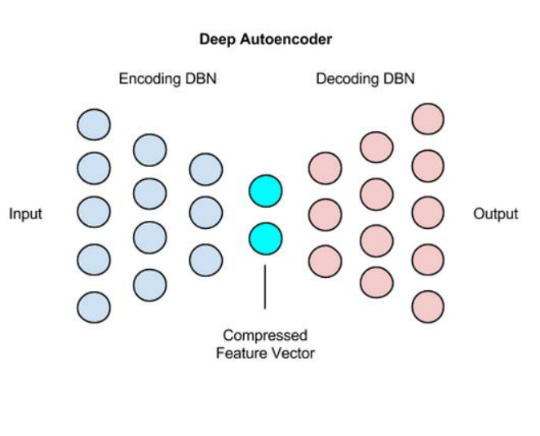
SYSTEM ARCHITECTURE :
Fig: System Architecture of Autoencoders

Slide 7
ALGORITHMIC SURVEY :
Basic Autoencoder: The simplest form, consisting of an encoder and a decoder, used for dimensionality reduction and reconstruction tasks. It learns a compressed latent representation of input data.
Contractive Autoencoder: Adds a regularization term to penalize small changes in input that cause large changes in the representation. This improves the model's robustness to small perturbations in the data.

Slide 8
RESULT ANALYSIS :
Reconstruction Quality: How well the output resembles the input after encoding and decoding. Poor reconstructions may indicate underfitting or overfitting.
Latent Space Representation: Examining the reduced-dimensional latent space for meaningful patterns or separations, which can be used for clustering or visualization.
Overfitting Risk: If the autoencoder memorizes the training data without generalizing well to unseen data, regularization techniques (e.g., dropout or adding noise) can be applied.
Applications: Autoencoder results are further analyzed based on the task, such as improved image quality for denoising, anomaly detection accuracy, or efficient feature extraction for downstream models.

Slide 9
ADVANTAGES & APPLICATIONS :
Unsupervised Learning: They do not require labeled data, making them useful for tasks where annotated datasets are unavailable.
Dimensionality Reduction: Autoencoders can compress high-dimensional data into a lower-dimensional latent space, preserving important features, and can be an alternative to techniques like PCA.
Noise Reduction: Denoising autoencoders are particularly good at removing noise from data, such as enhancing image quality by eliminating unwanted artifacts.
Anomaly Detection: Autoencoders can detect anomalies by reconstructing data; large reconstruction errors indicate deviations from normal patterns.
Feature Learning: They automatically learn relevant features and representations from the data, which can be used as input for other machine learning models.
Data Generation: Variational autoencoders (VAEs) can generate new, similar data samples by sampling from the learned latent space, useful for synthetic data creation.

Slide 10
ADVANTAGES & APPLICATIONS :
Applications:
Data Compression
Image Generation
Recommendation Systems
Feature Extraction

Slide 11
FUTURE SCOPE :
Autoencoders have a wide feature scope, particularly in dimensionality reduction, where they can efficiently compress high-dimensional data while preserving essential patterns. They are also valuable for noise reduction, learning to remove unwanted noise from data like images or audio. In anomaly detection, autoencoders identify rare patterns by highlighting deviations from normal data reconstructions. Additionally, they serve as feature extractors in unsupervised learning, offering compact and meaningful representations for tasks like clustering or classification.

Slide 12
REFERENCES :
Autoencoders Based Deep Learner for Image Denoising Komal Bajaja, Dushyant Kumar Singhb, Mohd. Aquib Ansaric
An Introduction To Autoencoders Dibyendu Barman, Abul Hasnat, Rupam Nag

Slide 13
CONCLUSION :
Autoencoders are a powerful deep learning tool for representation learning, generative modeling, and feature extraction, with applications in computer vision, natural language processing, and more. They enable efficient data compression, robust anomaly detection, and improved performance in various AI tasks. Ongoing innovations continue to expand their capabilities and applications.

Slide 14
THANK YOU !

